Slide 1






Structural analysis and generation of materials: AFLOW-SYM, AFLOW Prototype Encyclopedia, and AFLOW-XtalFinder
v
David Hicks
AFLOW – Johns Hopkins University
Session 2
Wednesday, September 21st, 2022
Advanced Research Computing at Hopkins

Slide 2
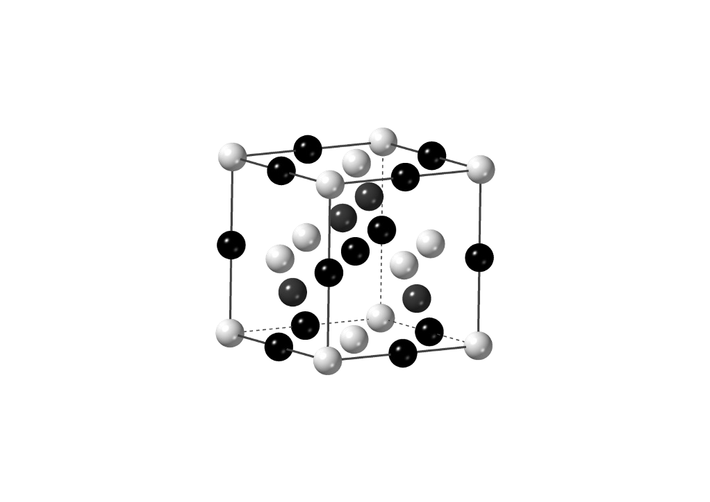
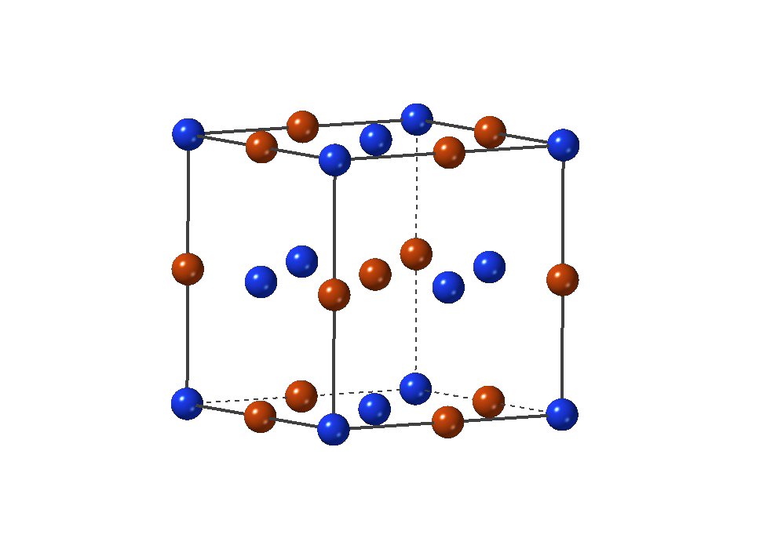
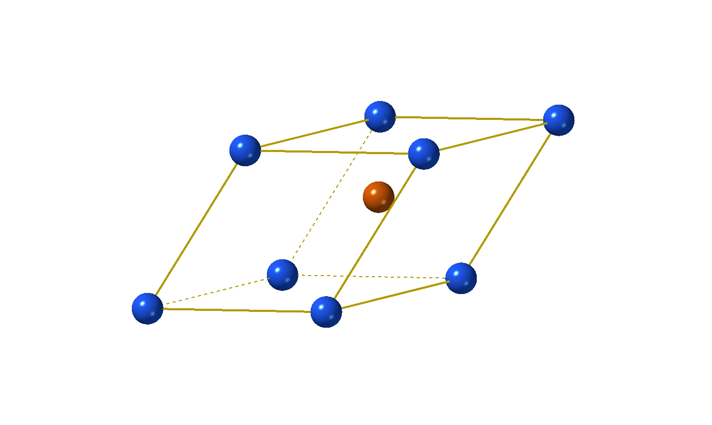
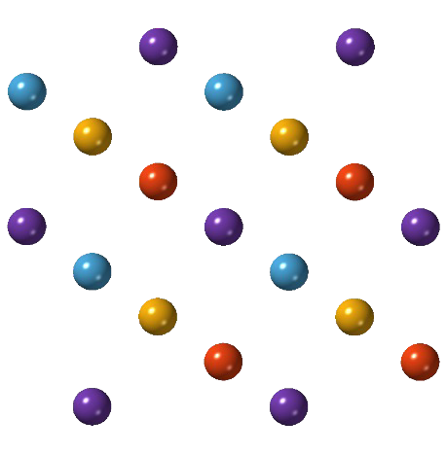



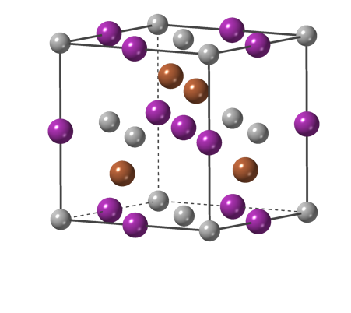
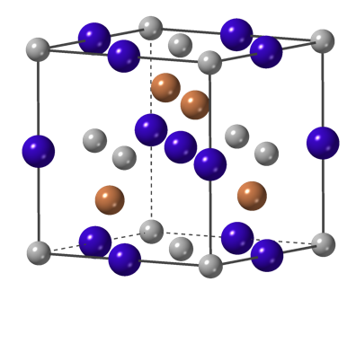
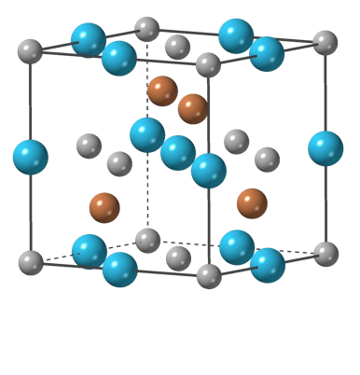

Structure features for ML
structural tools to aid ML training and generate hypothetical materials
features for training
structure analysis
crystal generation engine
prototype
C₄
S₂
feature vectors
train new models
PtSbSc
PtSbTb
PtSbHo
ML
Egap

Slide 3

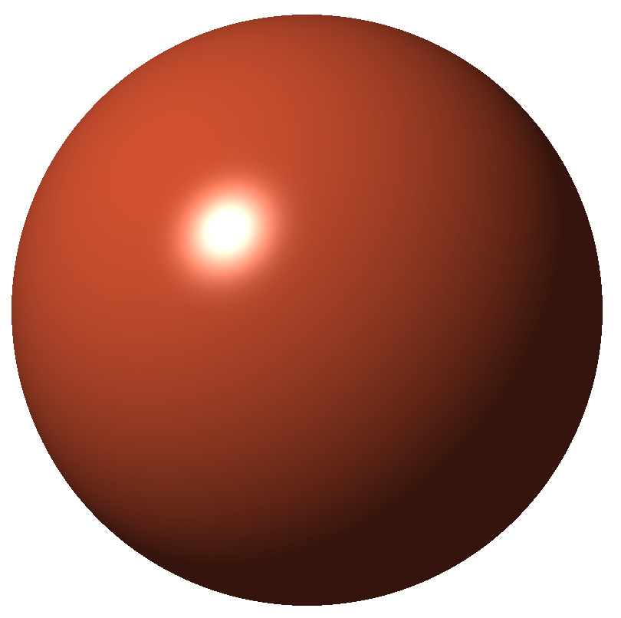

AFLOW-SYM
AFLOW-SYM tests invariance of crystal under transformations
a
b
mirror
n-fold
✓
x_{j}
x_{i}
space group
Bravais lattice
conventional cell
…
descriptions:
Pearson symbol
Wyckoff positions
primitive cell
Hicks et al., Acta Cryst. A74, 184 (2018)

Slide 4
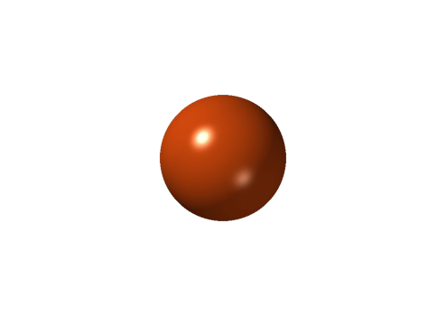
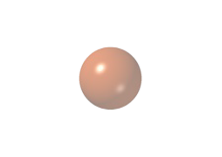
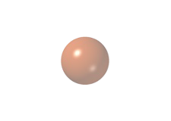
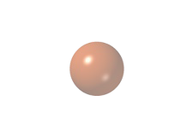
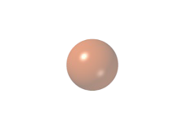

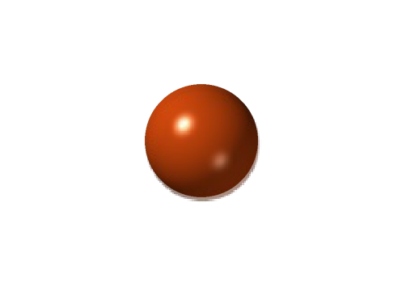
Identifying symmetry elements
attempt symmetry operation
mapped
4-fold rotation (90º)
mapped
mapped?
radius (threshold for mappings)
||xorig - xtransformed||  ✏
periodic boundary conditions
mappings in non-uniform metric spaces
✕ not mapped
Hicks et al., Acta Cryst. A74, 184 (2018)

Slide 5
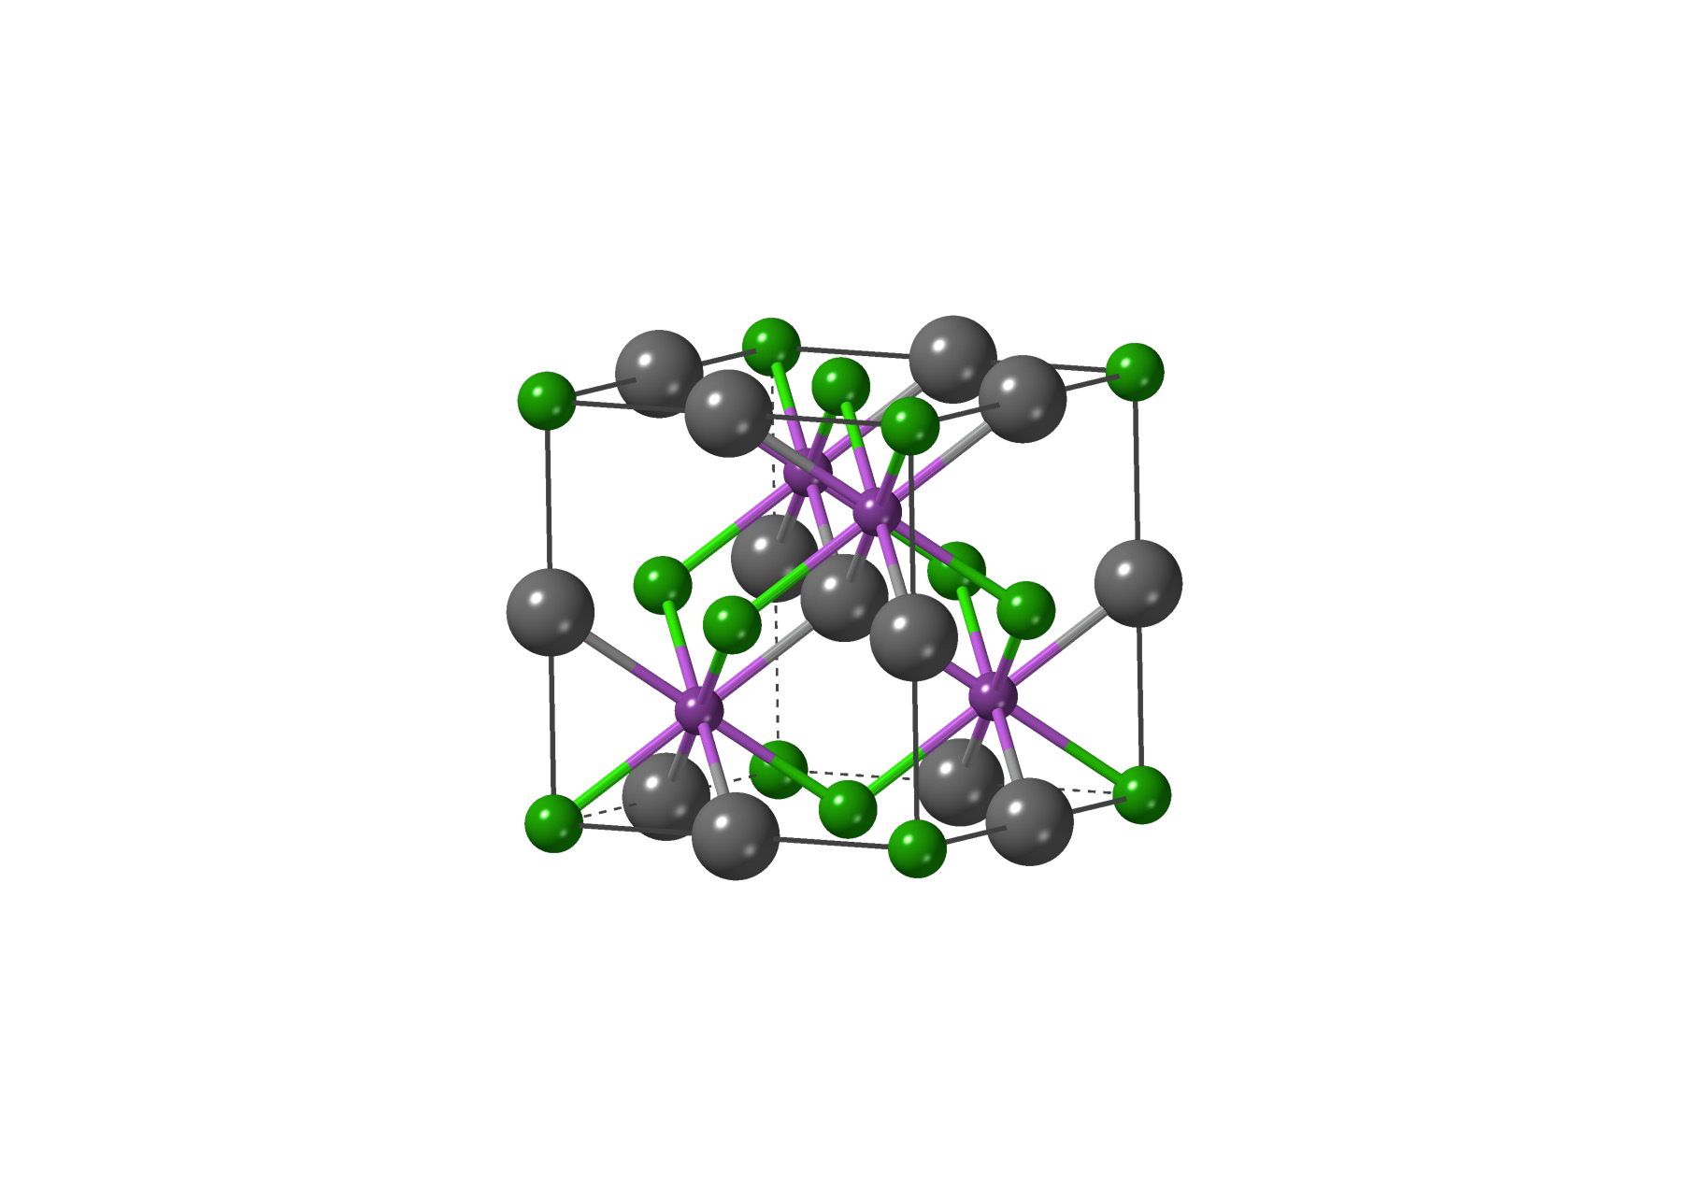
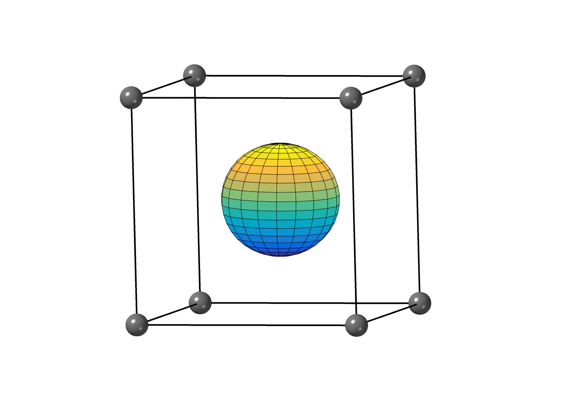
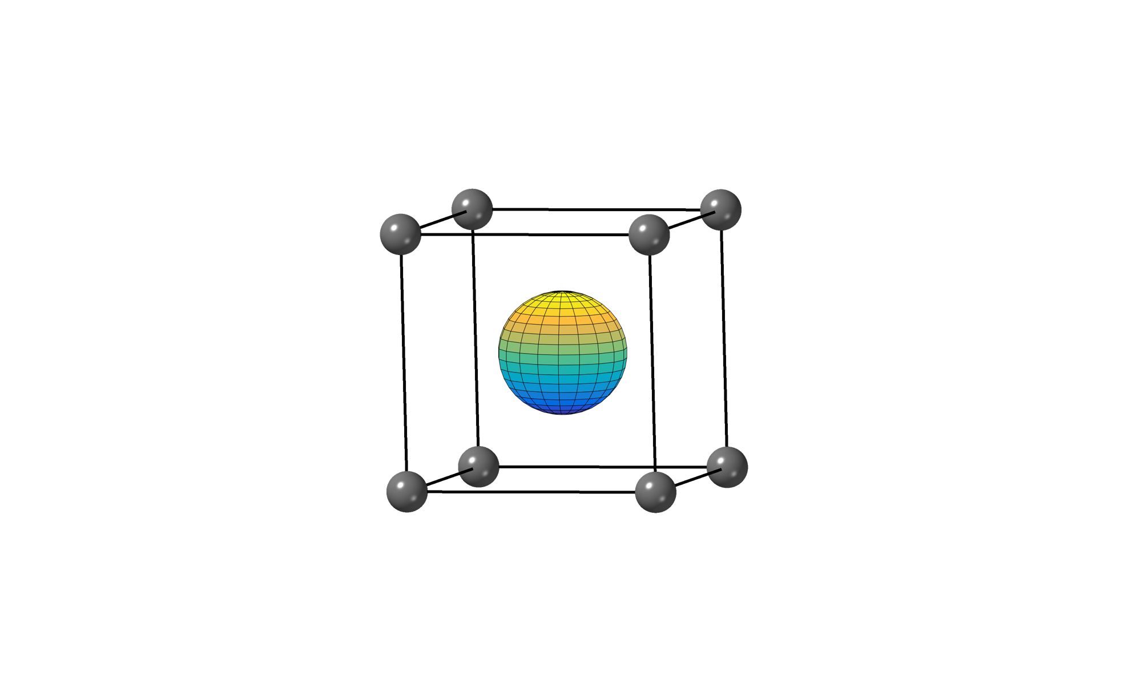
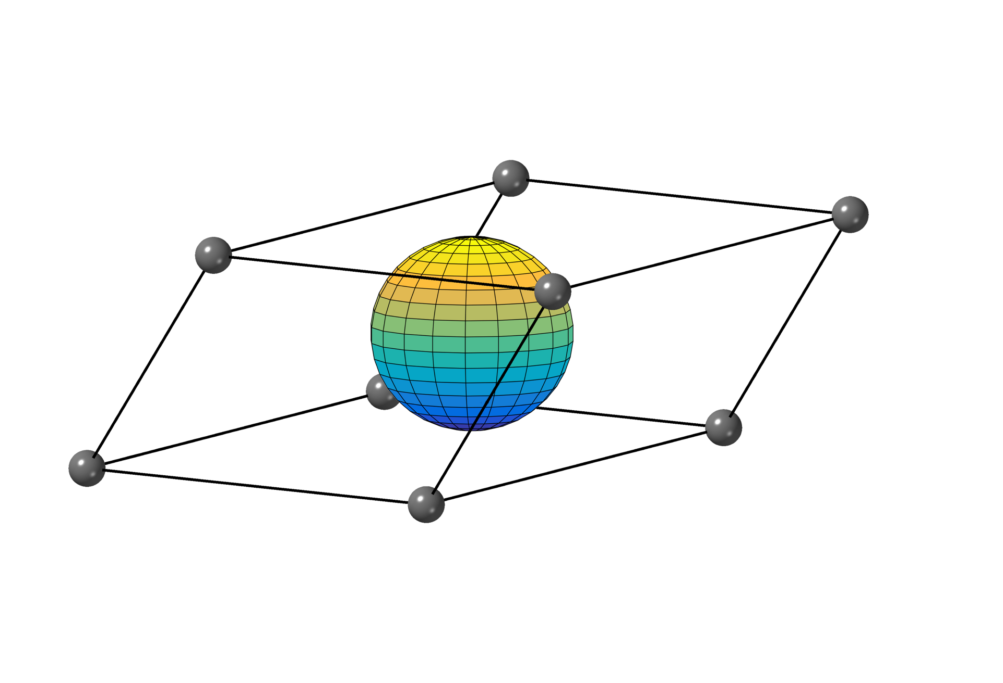
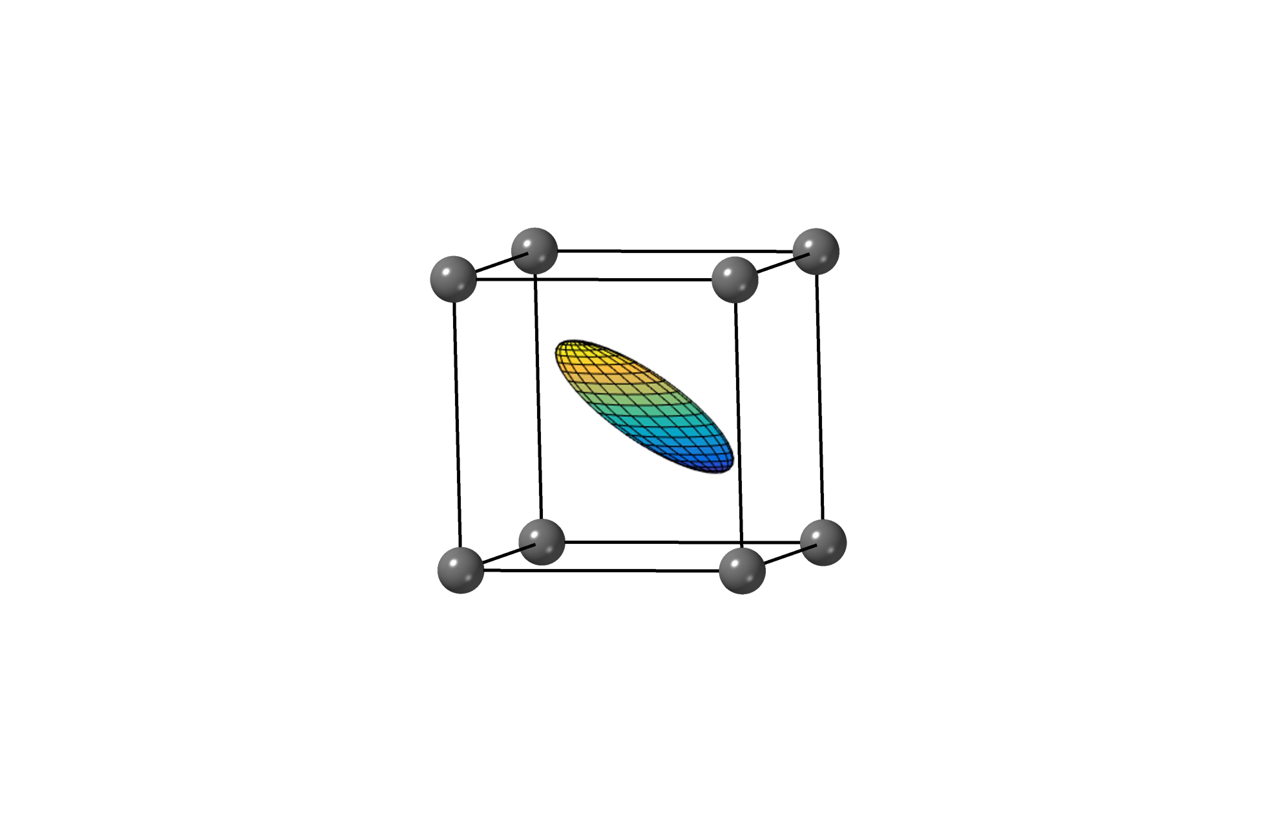
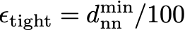
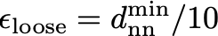




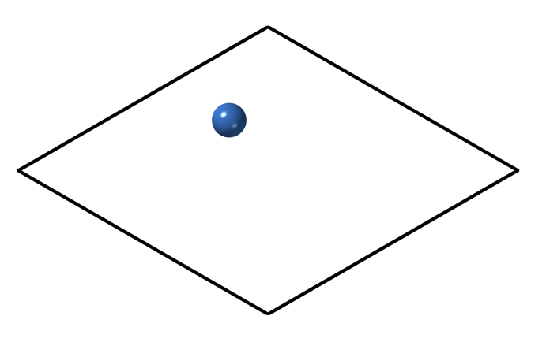
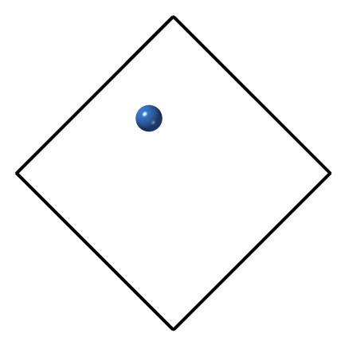
Algorithm improvements
robust mapping procedure
accurate in both direct and reciprocal spaces
cartesian fractional
adaptive tolerance scheme
ensures self-consistent symmetry
system-specific tolerance
atomic position resolution
mcl SG: #11
orc SG #59
nearest-neighbor analysis
rhl SG #166
fcc SG #225
0
0.5
1.0
cartesian
fractional
b
_{d}min
c
✓
_{d}emin
_{d}emin
single global tolerance
nˆ_{m}
c
f
0.1
0.3
✏₀
✏new
Hicks et al., Acta Cryst. A74, 184 (2018)

Slide 6



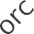



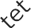
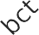



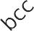
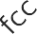
Benchmark with existing packages
Mismatch with respect to space group listed in description of experimental structure in ICSD
Hicks et al., Acta Cryst. A74, 184 (2018)

Slide 7
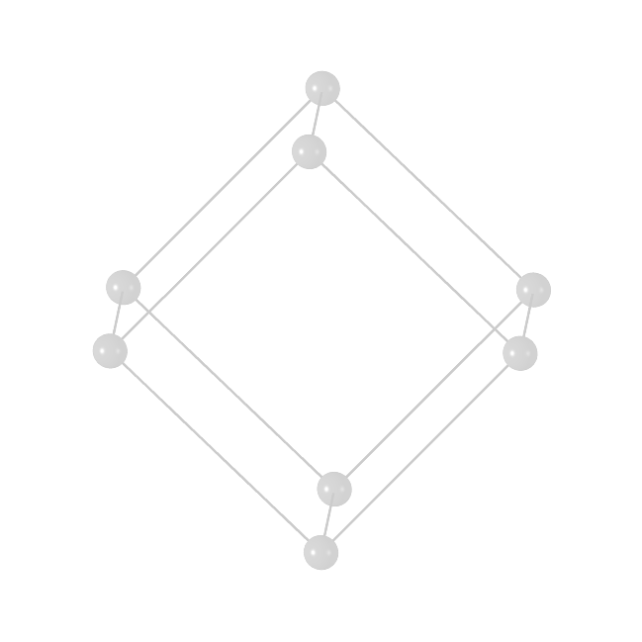
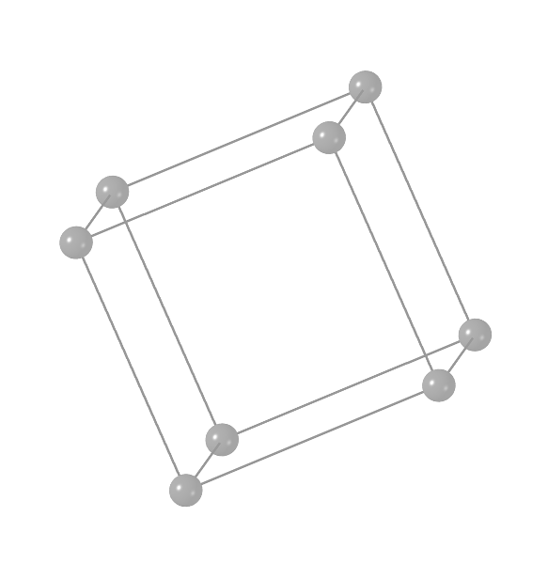
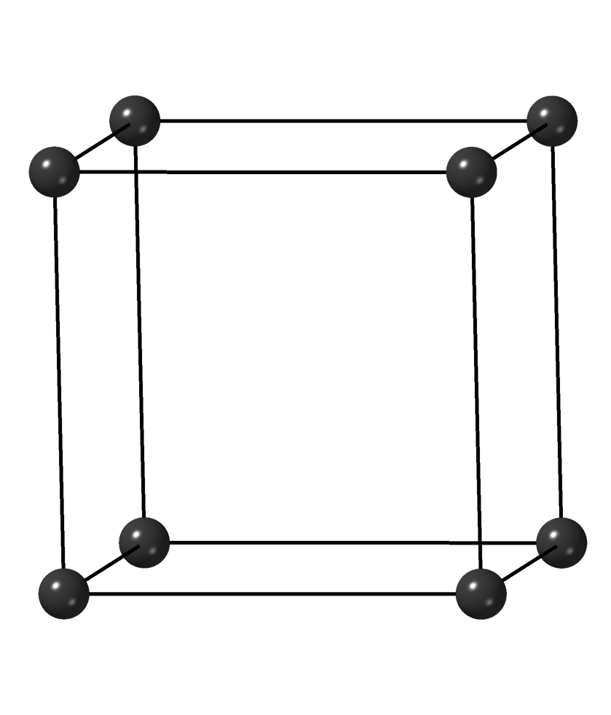
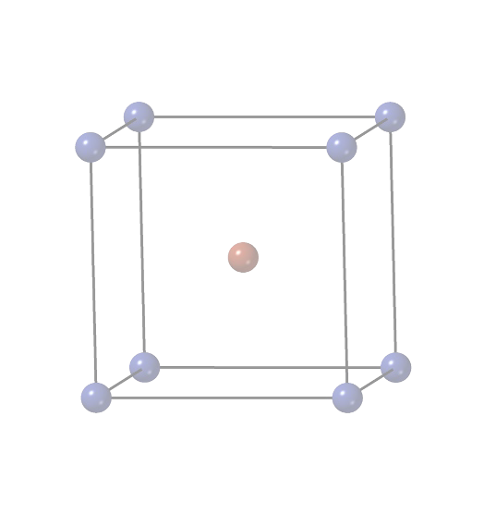
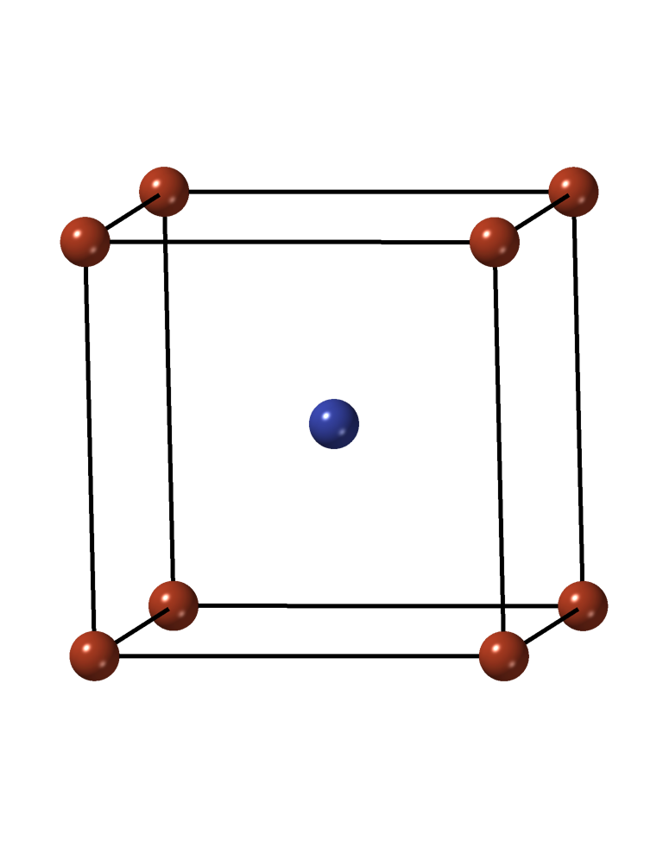
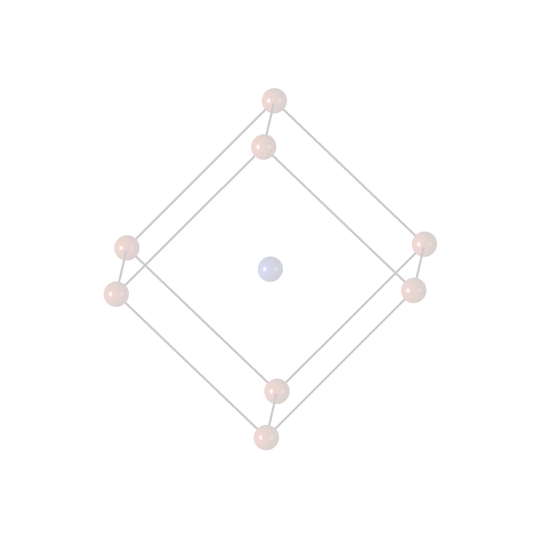
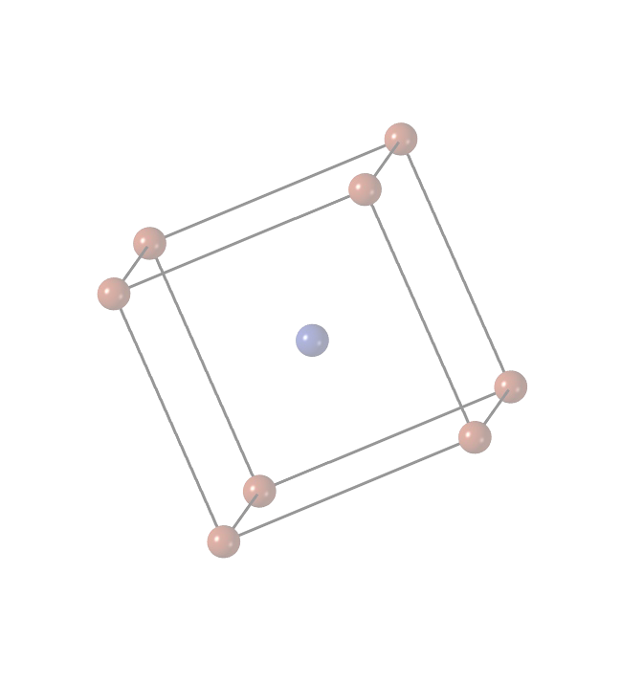
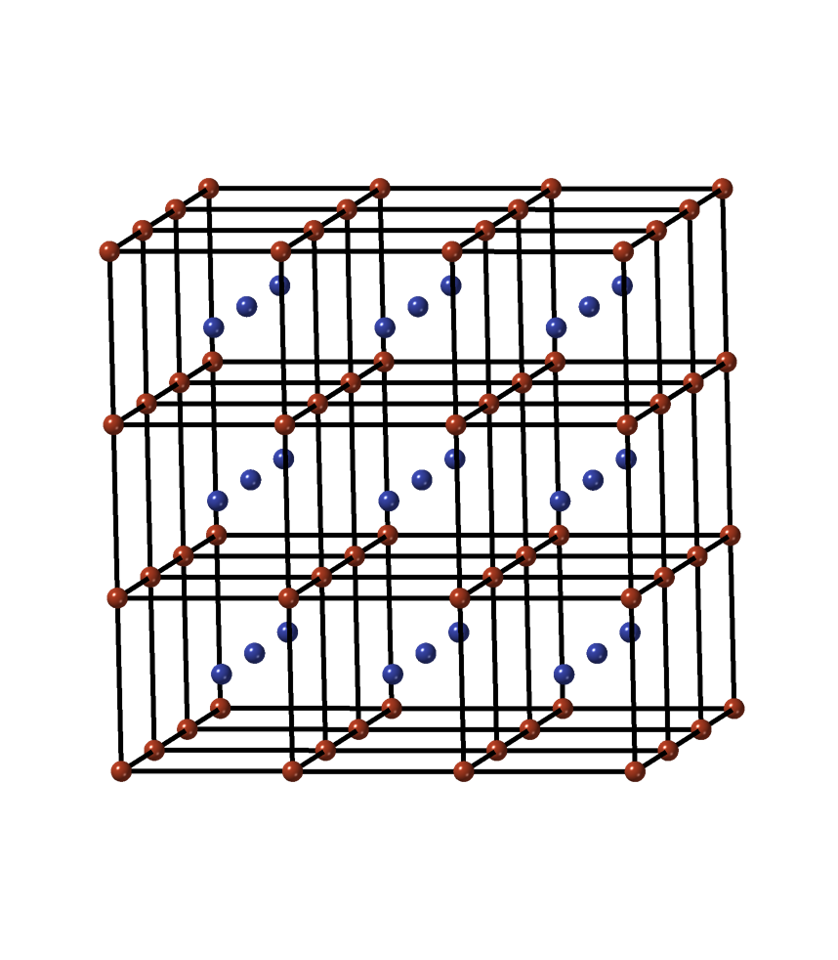
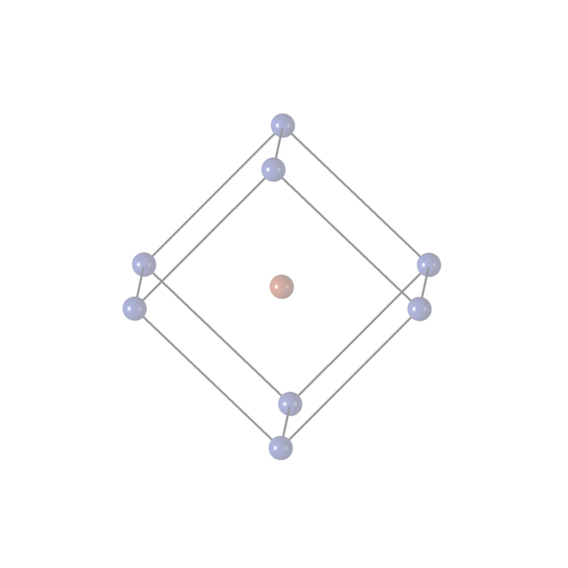
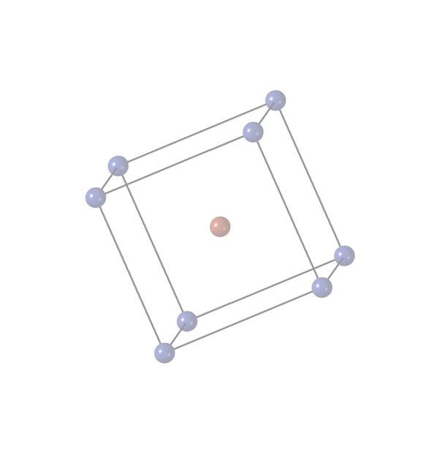
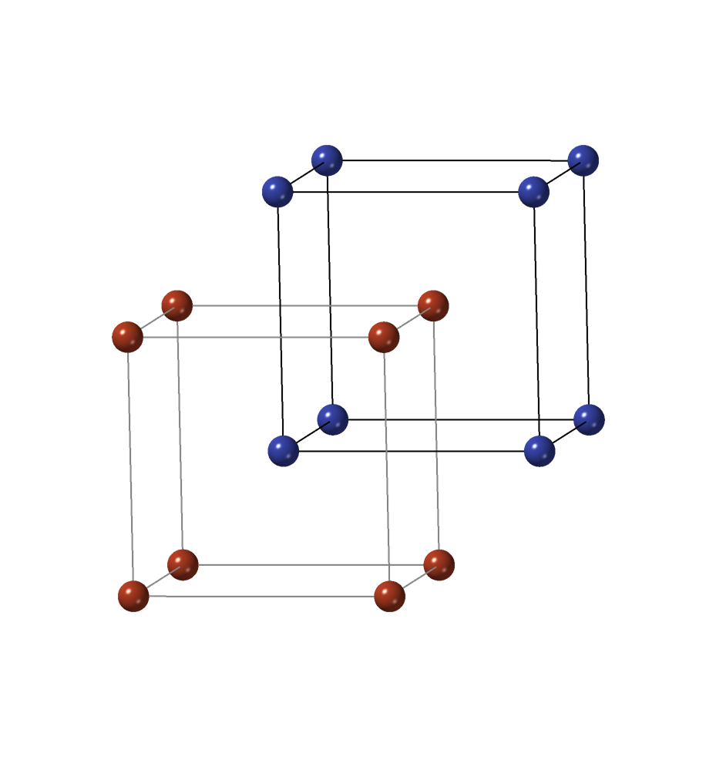
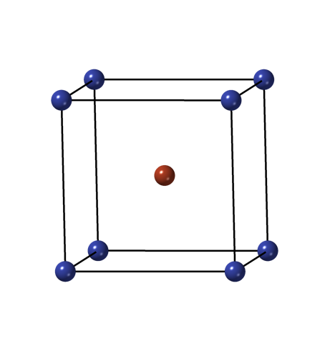

Crystallographic symmetry
Calculates the relevant symmetry groups for crystallographic structures
lattice point group
reciprocal lattice point group (BZ symmetry) factor group (unit cell symmetry) crystallographic point group
dual of crystallographic point group (IBZ symmetry)
Patterson symmetry group space group
site point group (atom point symmetry)
Hicks et al., Acta Cryst. A74, 184 (2018)

Slide 8
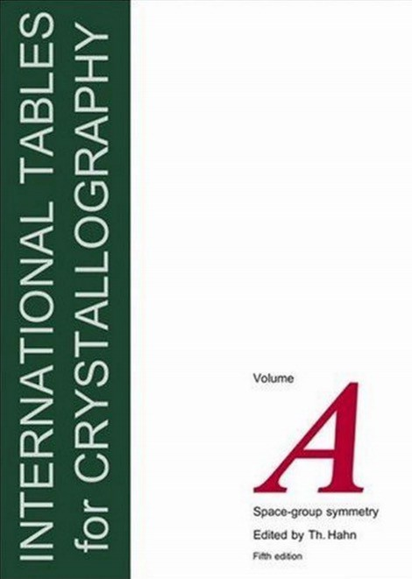
Symmetry descriptions
space group number (1-230)
225
International (Hermann-Mauguin)
𝐹𝑚3#𝑚
Schoenflies
consistent with International Tables for Crystallography (ITC)
standard space group label
space group setting
Wyckoff positions
Ag 4 a 0, 0, 0
_{𝑂}"
multiplicity
!
Hall symbol
𝐹 4/𝑚 −3 2/𝑚
Pearson symbol
cF4
letter designation
representative coordinate
expand coordinates
Ag 0, 0, 0
Ag 0, 1/2, 1/2
Ag 1/2, 0, 1/2 Ag 1/2, 1/2, 0
Hicks et al., Acta Cryst. A74, 184 (2018); Hahn, Kluwer Academic Publishers (2002)
8

Slide 9
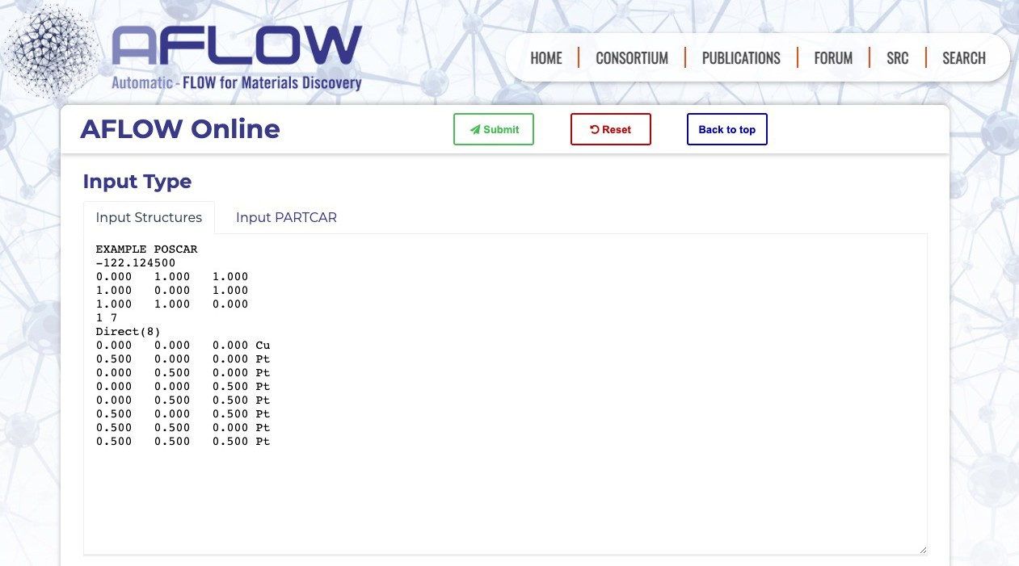
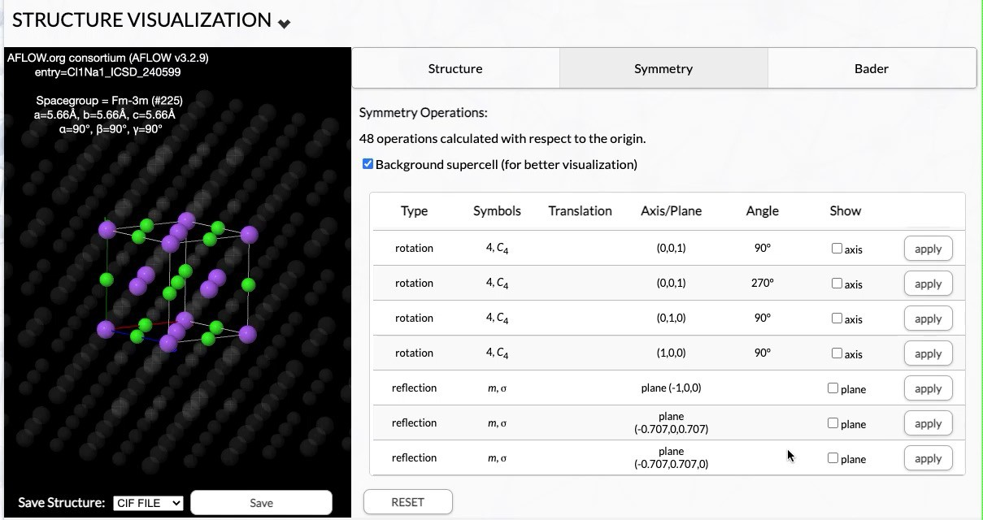
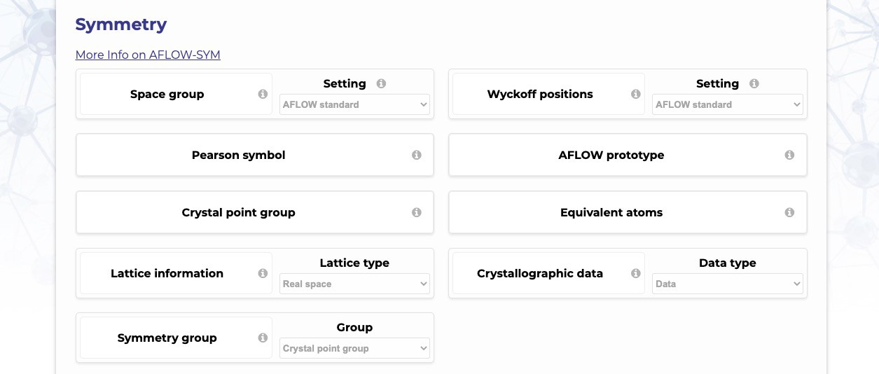
AFLOW-SYM: online
online functionality aflow.org/aflow-online
visualize symmetry operations on entry pages of aflow.org

Slide 10
Navigate to AFLOW-Online (aflow.org/aflow-online)

Slide 11
AFLOW Crystal Prototype Encyclopedia

Slide 12
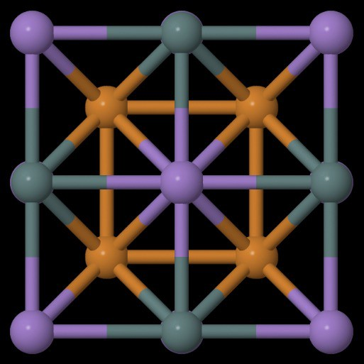
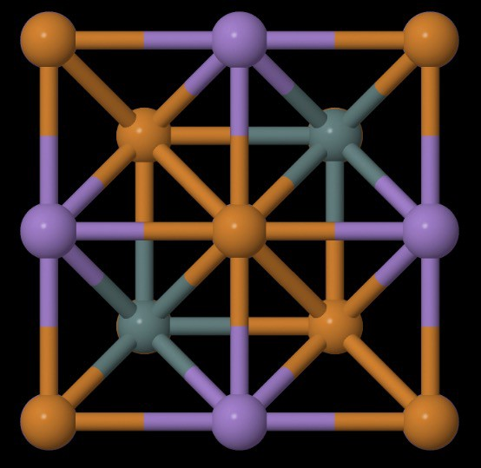
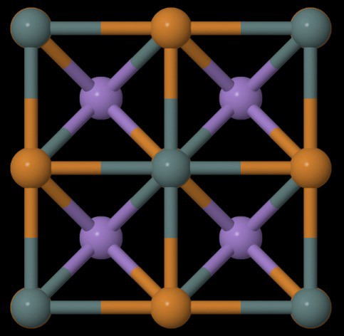
AFLOW: Crystallographic prototypes
AFLOW contains built-in structural prototypes:
Prototype T0001: Heusler structure
Prototype T0002: Anti-Heusler structure
Prototype T0003: Half-Heusler structure
Decorating prototypes with different elements allows for automated creation of new hypothetical materials
~1,100 prototypes available at aflow.org/prototype-encyclopedia
Mehl et al., Comput. Mater. Sci. 136, S1 (2017); Hicks et al., Comput. Mater. Sci. 161, S1 (2019); Hicks et al., Comput. Mater. Sci. 199, 110450 (2021)

Slide 13
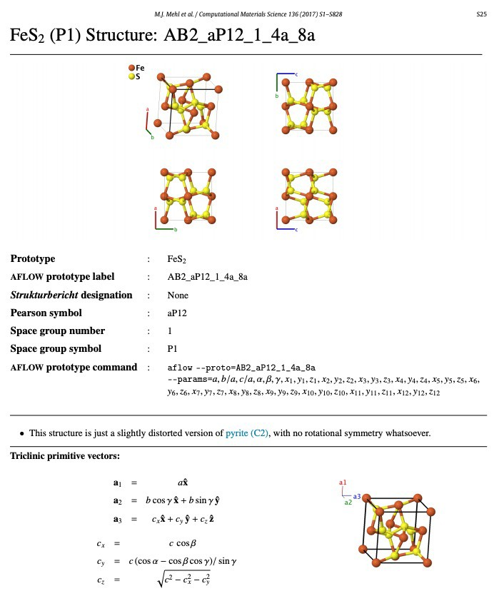
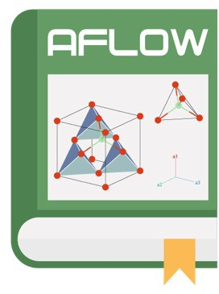
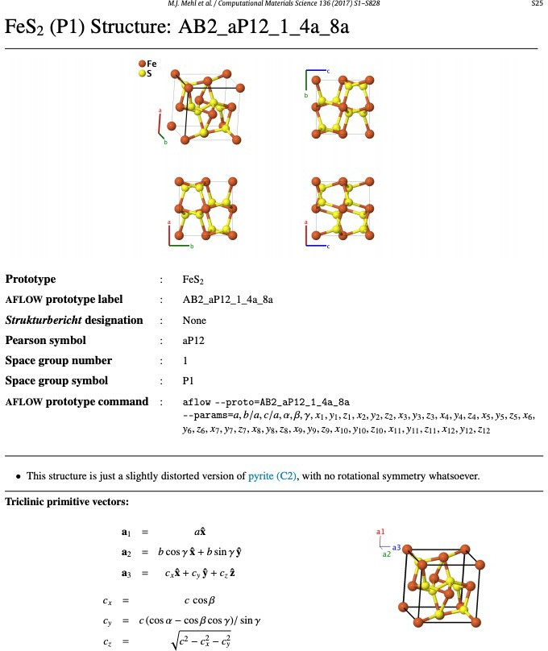
Crystal Prototype Encyclopedia
The AFLOW Prototype Encyclopedia
content
standard label
Strukturbericht
historic labels
similar compounds
Wyckoff positions
Pearson symbol
space group
explicit coordinates
lattice vectors
visualizations
prototypes are integrated into AFLOW software = automatic materials generation
part 1
288 prototypes
part 2
302 prototypes
part 3
510 prototypes
1,100
prototypes
Mehl et al., Comput. Mater. Sci. 136, S1 (2017); Hicks et al., Comput. Mater. Sci. 161, S1 (2019); Hicks et al., Comput. Mater. Sci. 199, 110450 (2021)

Slide 14



Standard designation and generation
Descriptive label and method for generation (e.g., wurtzite)
AFLOW parameters
degrees of freedom consistent with symmetry
AFLOW label
reduced stoichiometry
Pearson symbol
space group number
a
c/a
z₁ z₂
AB_hP4_186_b_b
3.823,1.099,0.375,0
3.823,1.638,0.270,0
3.823,1.638,0.375,0
species A
Wyckoff letter(s)
species B
Wyckoff letter(s)
Mehl et al., Comput. Mater. Sci. 136, S1 (2017); Hicks et al., Comput. Mater. Sci. 161, S1 (2019); Hicks et al., Comput. Mater. Sci. 199, 110450 (2021)

Slide 15
Navigate to Prototype Encyclopedia (aflow.org/prototype-encyclopedia)

Slide 16




Online application
www.aflow.org/prototype-encyclopedia
Jmol viewer
search by structure descriptors
general prototype info
Mehl et al., Comput. Mater. Sci. 136, S1 (2017); Hicks et al., Comput. Mater. Sci. 161, S1 (2019); Hicks et al., Comput. Mater. Sci. 199, 110450 (2021)

Slide 17


Online application
www.aflow.org/prototype-encyclopedia
prototype generator
17
lattice and atom information (symbolic notation)
Mehl et al., Comput. Mater. Sci. 136, S1 (2017); Hicks et al., Comput. Mater. Sci. 161, S1 (2019); Hicks et al., Comput. Mater. Sci. 199, 110450 (2021)

Slide 18
AFLOW-XtalFinder

Slide 19





































Search for structural diversity
programmatically search for distinct structures in datasets
lattice and origin choices obfuscate similarity
Ex:
mitigate duplicates
data mining (statistics)
machine learning
identify prototypes
decorate structures
materials discovery
AFLOW-XtalFinder
Hicks et al., npj Comput. Mater. 7, 30 (2021)
19

Slide 20

Autonomous prototype finder
IDENTIFICATION: find prototype of crystalline material
self-consistent crystal prototype finder
scan
✏sym
0
0.25
0.5
Hicks et al., npj Comput. Mater. 7, 30 (2021)

Slide 21










Structural uniqueness
symmetry comparison
local geometry comparison
geometric comparison
S₂
a
lattice + origin search
C₄
0₀
0₀
local LFA geometry
-1 0
0 0
0 0 1
C₄
1 0
S = 1 0 0
0 0 1
@
A
. . . 2
@
A
C = 1
4
similarity metrics
S₂
lattice differences
0₀
0₀
1 0
0 0
0 0 1
coordination analysis
matched or unmatched atoms
-1 0
0 0
0 0 1
@
A
@
A
. . .
S = 1
C = 1
2
_{d}map
4
isopointal structures
local snapshots
isoconfigurational
Hicks et al., npj Comput. Mater. 7, 30 (2021)
21

Slide 22










Compare against repositories
compare user structure sets
compare to Prototype Encyclopedia
compare to AFLOW database
input structure
input structure
?
?
database (via AFLUX)
structure similarity vs properties
label: ABC_cF12_216_b_c_a common name: half-Heusler Strukturbericht: C1_{b}
web: aflow.org/prototype-encyclopedia/ ABC_cF12_216_b_c_a.html
automatically groups similar structures
matching entry
ccoommppoouunndd | aauuiidd | mmiissfifitt | H_{atom} (eV/atom)
CCll11NNaa11 | aaflflooww::eecc2233002299aa1188dd33ffeecc99 | 00..0000338844 | -3.39049
CCll11NNaa11 | aaflflooww::bb22eecc44bb6688ee1122ff33667744 | 00..0000441155 | -3.39056
CCll11NNaa11 | aaflflooww::11335544bbbbeeff44eedddd8800bb33 | 00..0000339944 | -3.39032
CCll11NNaa11 | aaflflooww::11ccdd7711111144997722dd4466dddd | 00..0000552255 | -3.39078
CCll11NNaa11 | aaflflooww::99001177ff99cc6644eeaadd2222aabb | 00..0000444455 | -3.39062
Mehl et al., Comput. Mater. Sci. 136, S1 (2017); Hicks et al., Comput. Mater. Sci. 161, S1 (2019); Rose et al., Comput. Mater. Sci. 137, 362 (2017); Hicks et al., npj Comput. Mater. 7, 30 (2021)
22

Slide 23
Navigate to AFLOW-Online (aflow.org/aflow-online)

Slide 24
Exercises
Navigate to http://aflow.org/prototype-encyclopedia/A2B7C2_tI44_119_i_bdefgh_i. Generate a geometry file with the default parameters and calculate the space group on http://aflow.org/aflow-online? What space group(s) do you find if you change the tolerance from “tight” to “loose”?
Navigate to the following AFLOW entry: http://aflow.org/material/?id=aflow:44368cc42c6f60cc. At the bottom of the page, click on the “VASP-CONTCAR” under “Relaxed Structure” and copy the geometry file. On AFLOW-Online, determine the prototype designation via the “AFLOW prototype” button. How many degrees of freedom are there (i.e., # of parameters)?
Navigate to the rock salt prototype page (https://aflow.org/prototype-encyclopedia/AB_cF8_225_a_b.html). Generate a sodium chloride crystal with the default parameters. On AFLOW-Online (http://aflow.org/aflow- online), use the “Compare to library” button and “Compare to AFLOW database” method and “Submit”. How many AFLOW entries match to the input? (HINT: Check for “compounds_duplicate=” in the output.)

Slide 25
Python modules
First, download AFLOW source code: http://aflow.org/install-aflow/
Generate Python modules via AFLOW command:
AFLOW-SYM:
aflow --aflow_sym_python
AFLOW-XtalFinder:
aflow --aflow_xtalfinder_python
Example scripts and functionality at http://aflow.org/aflow-schools

Slide 26
More information
For more functionality, download AFLOW source code: http://aflow.org/install-aflow/ READMEs:
aflow --readme=symmetry
aflow --readme=prototypes
aflow --readme=xtalfinder
Relevant articles:
AFLOW-SYM:
D. Hicks, C. Oses, R.H. Taylor, E. Gossett, G. Gomez, C. Toher, M.J. Mehl, O. Levy, and S. Curtarolo, AFLOW-SYM: Platform for the complete, automatic and self-consistent symmetry analysis of crystals, Acta Cryst. A74, 184-203 (2018). doi: 10.1107/S2053273318003066
Prototypes:
M.J. Mehl, D. Hicks, C. Toher, O. Levy, R.M. Hanson, G.L.W. Hart, and S. Curtarolo,
The AFLOW Library of Crystallographic Prototypes: Part 1, Comp. Mat. Sci. 136 Supplement, S1–S828 (2017). doi: 10.1016/j.commatsci.2017.01.017
D. Hicks, M.J. Mehl, E. Gossett, C. Toher, O. Levy, R.M. Hanson, G.L.W. Hart, and S. Curtarolo,
The AFLOW Library of Crystallographic Prototypes: Part 2, Comp. Mat. Sci. 161 Supplement, S1-S1011 (2019). doi: 10.1016/j.commatsci.2018.10.043
D. Hicks, M.J. Mehl, M. Esters, C. Oses, O. Levy, G.L.W. Hart, C. Toher, and S. Curtarolo,
The AFLOW Library of Crystallographic Prototypes: Part 3, in press, Comp. Mat. Sci. (2021). arXiv:2012.05961
AFLOW-XtalFinder:
D. Hicks, C. Toher, D.C. Ford, F. Rose, C. De Santo, O. Levy, M.J. Mehl, and S. Curtarolo, AFLOW-XtalFinder: a reliable choice to identify crystalline prototypes, npj Comput. Mater. 7, 30 (2017). doi: 10.1038/s41524-020-00483-4

